Slide 1
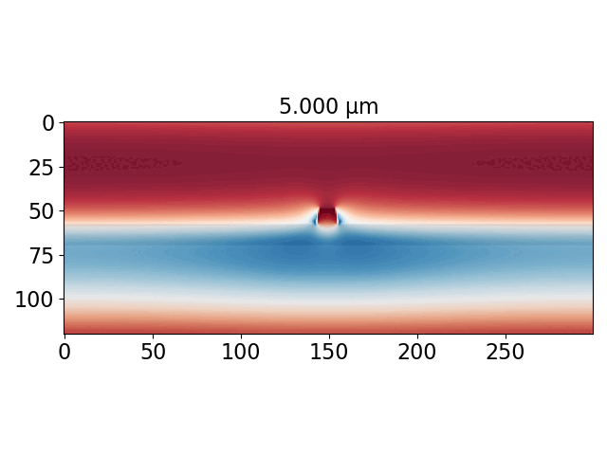
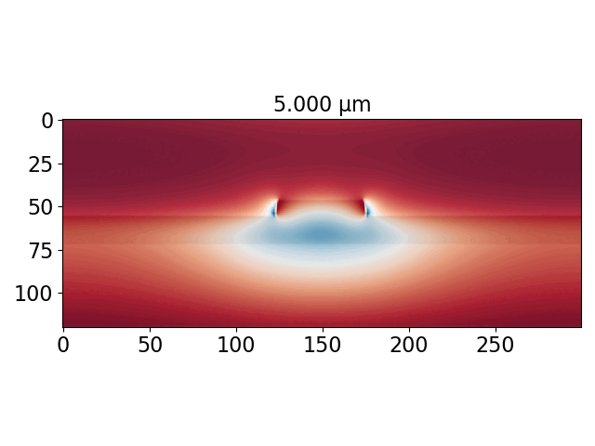
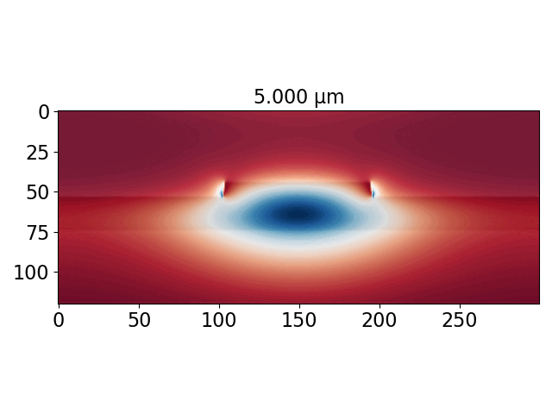
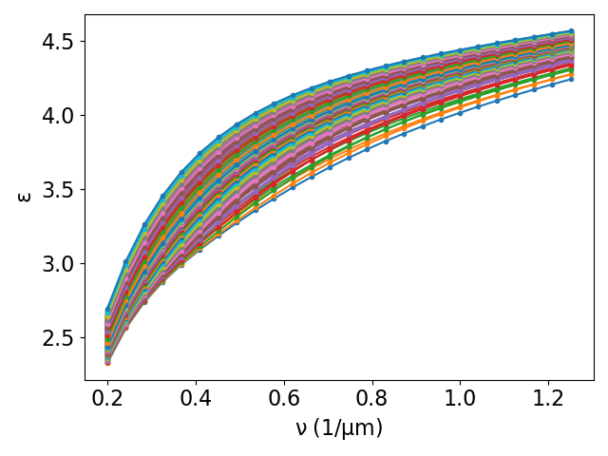
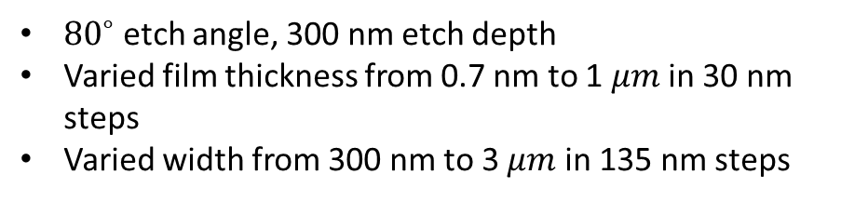
MEEP Mode Solver (MPB) for waveguide dispersion calculation
${80}^{∘}$ etch angle, 300 nm etch depth
Varied film thickness from 0.7 nm to 1 $μm$ in 30 nm steps
Varied width from 300 nm to 3 $μm$ in 135 nm steps

Slide 2
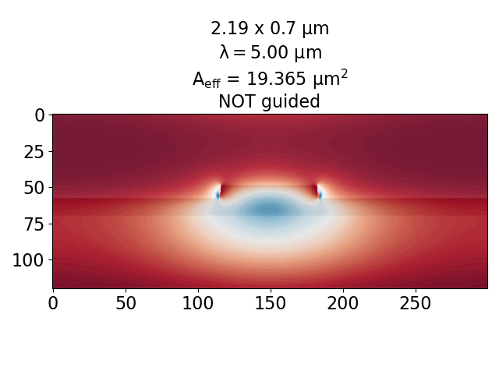
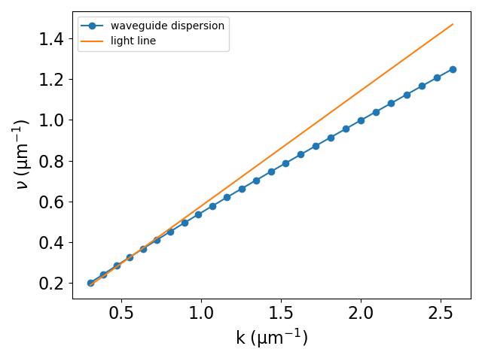
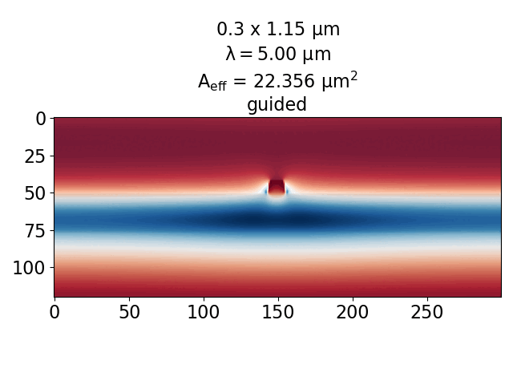

Guided wavelengths are below the light-line (to within numerical error)
300 nm $×$ 700 nm geometry

Slide 3
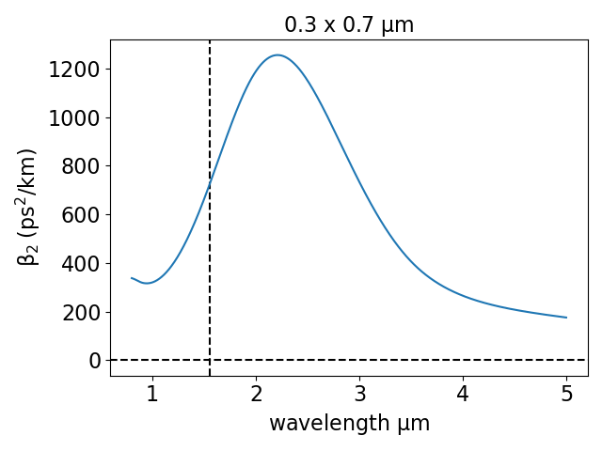
Vary etch width and waveguide deposition height

Slide 4
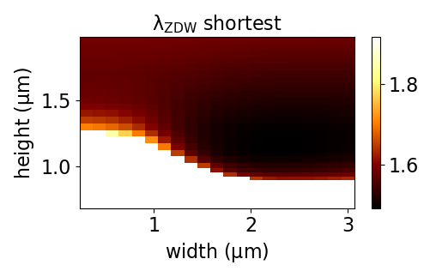
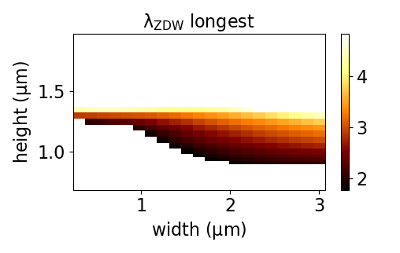
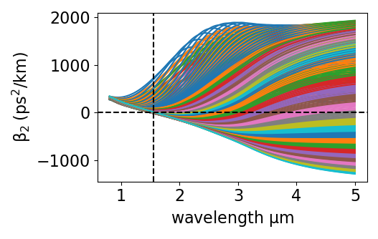
Vary etch width and waveguide deposition height

Slide 5
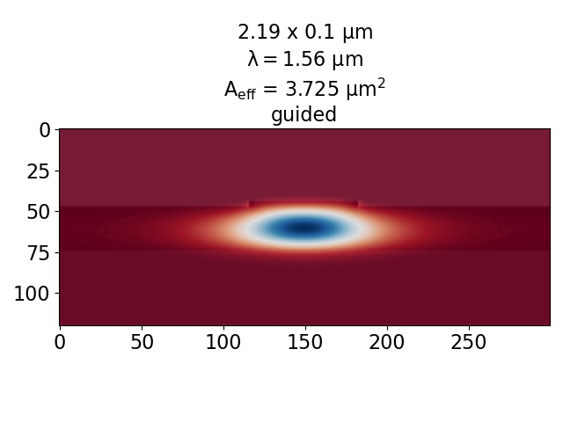
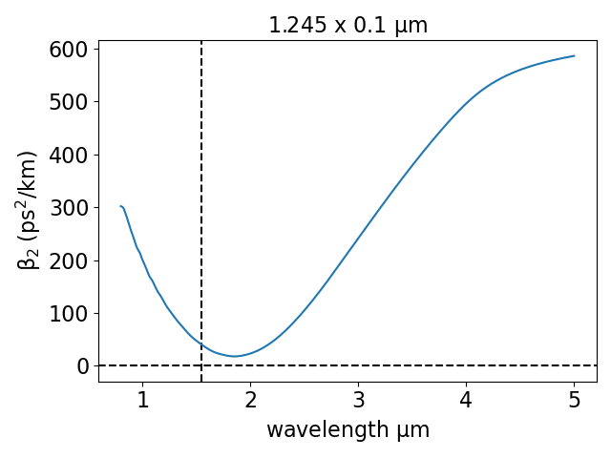
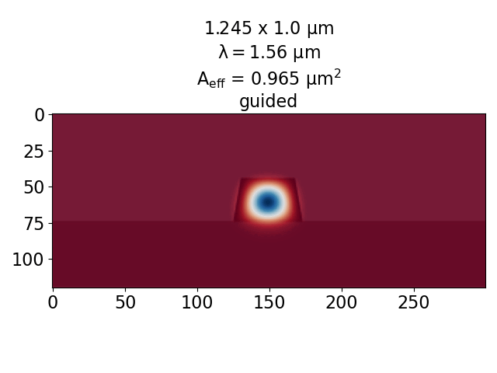
Vary etch width and etch depth (height = 1 $μm$)

Slide 6
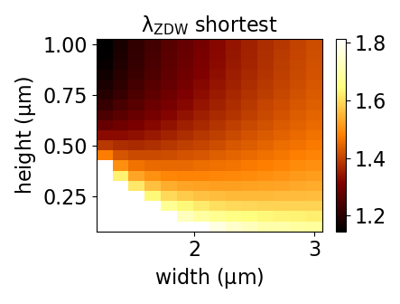
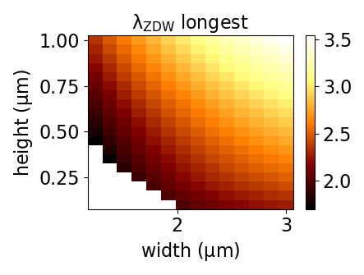
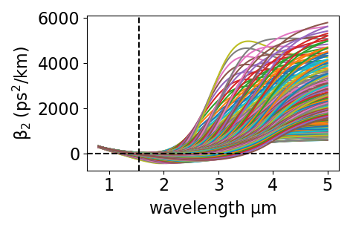
Vary etch width and etch depth (height = 1 $μm$)

Slide 7
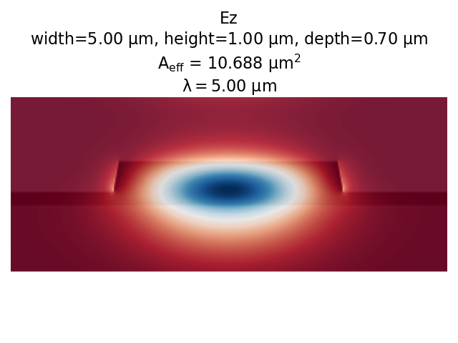
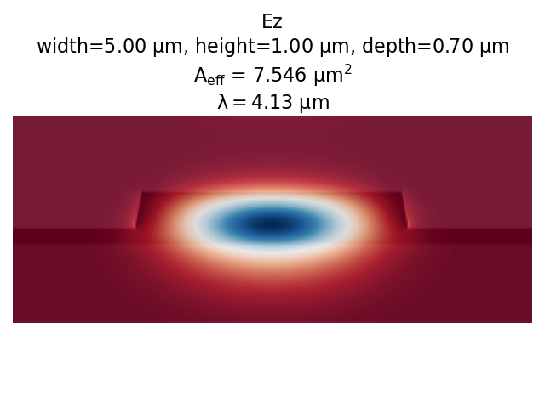

Slide 8
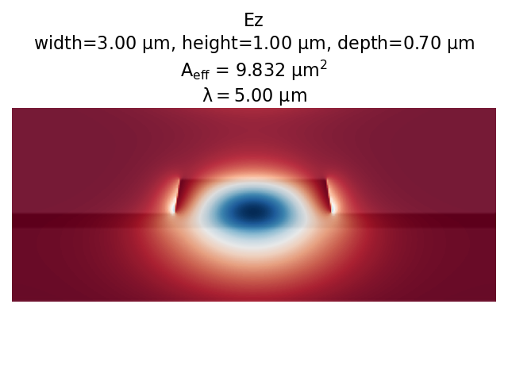
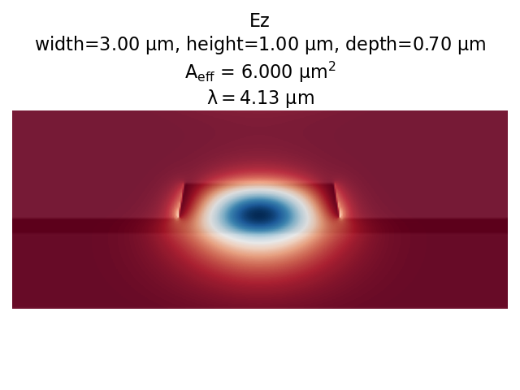

Slide 9
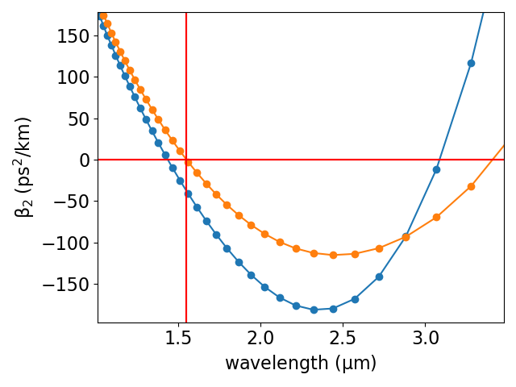


3$μm$ width
5$μm$ width
4 – 5 $μm$ is technically not guided, but are probably okay

Slide 10
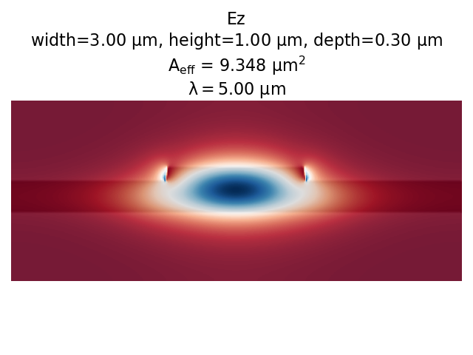
Suspended waveguide: light is guided with smaller dimensions

Slide 11
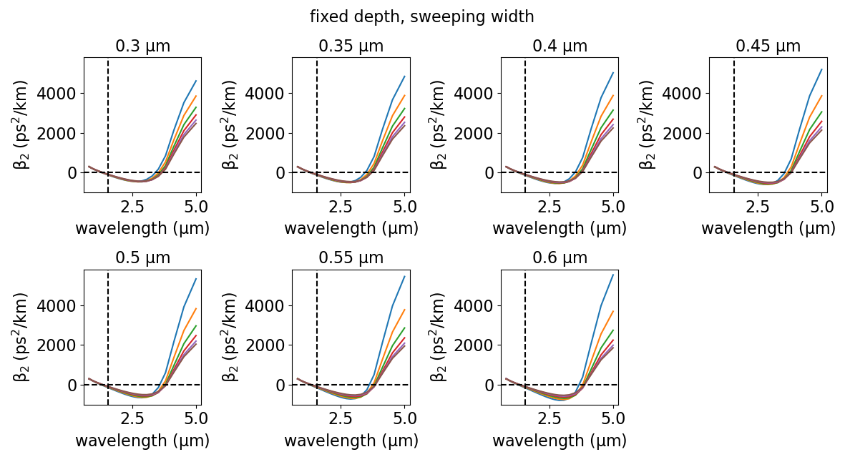

Slide 12
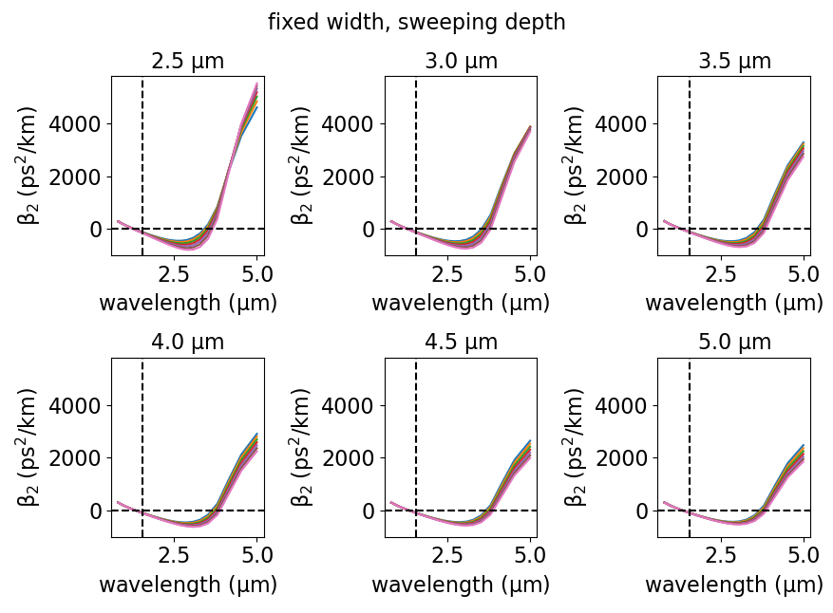

Slide 13
PyNLO simulations

Slide 14
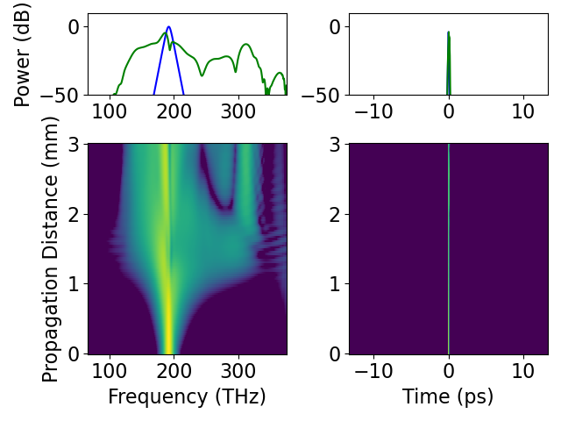
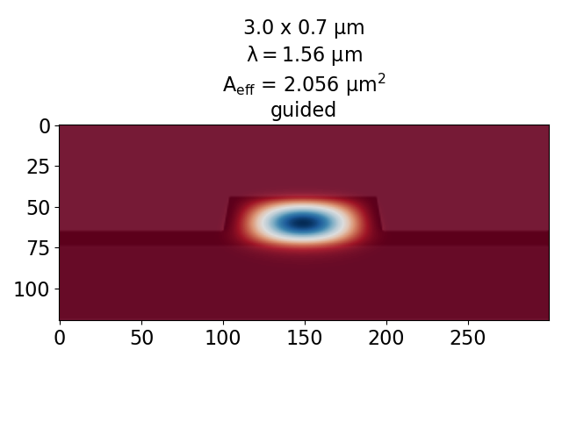
50 fs input pulse at 1550 nm

Slide 15
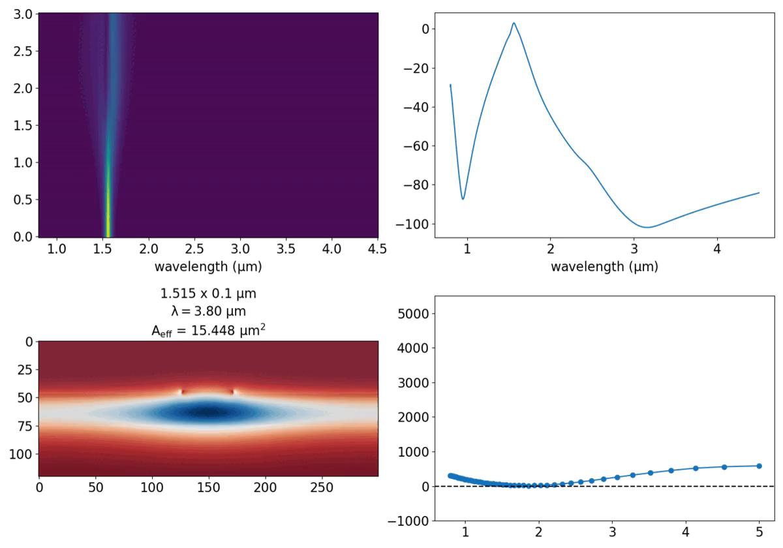

Slide 16
Scratch Slides

Slide 17
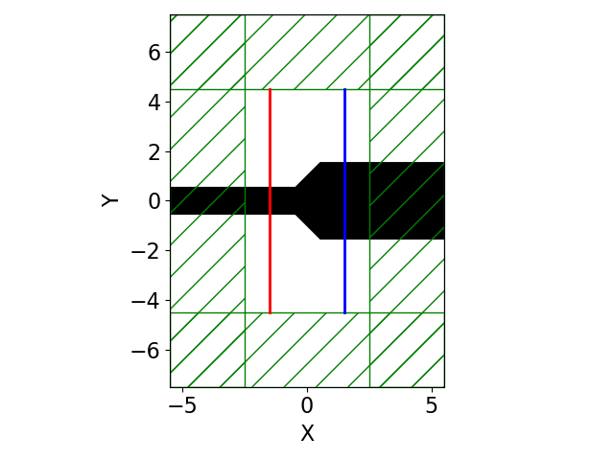
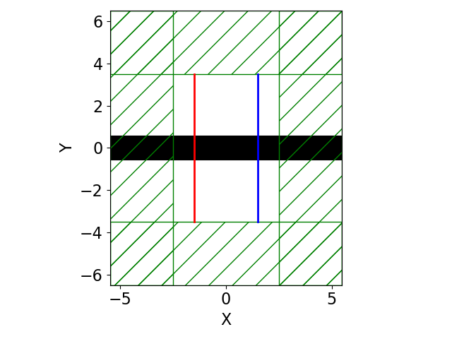
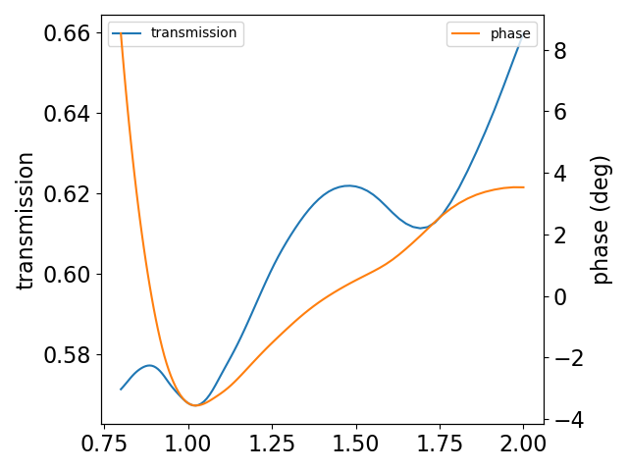

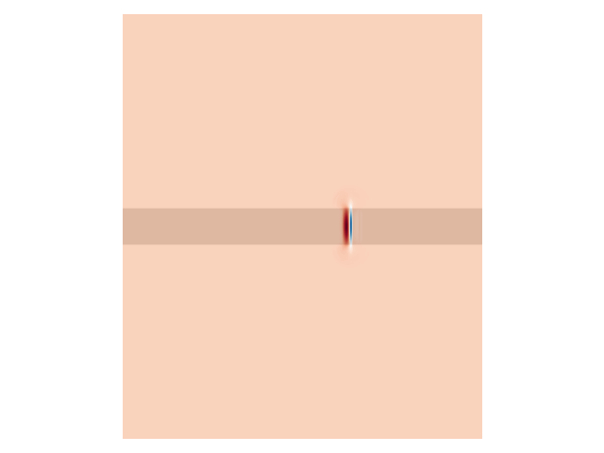
FDTD solver for taper transmission coefficient
2D example works fine
3D takes too long, >64 GB Memory and hours of run time (for dispersive materials)

Slide 18
PICARD Proposal
The figures in the following two slides are 300 dpi

Slide 19
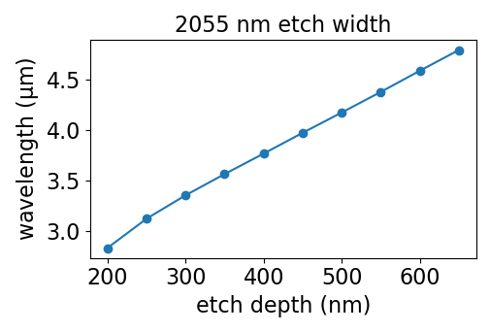
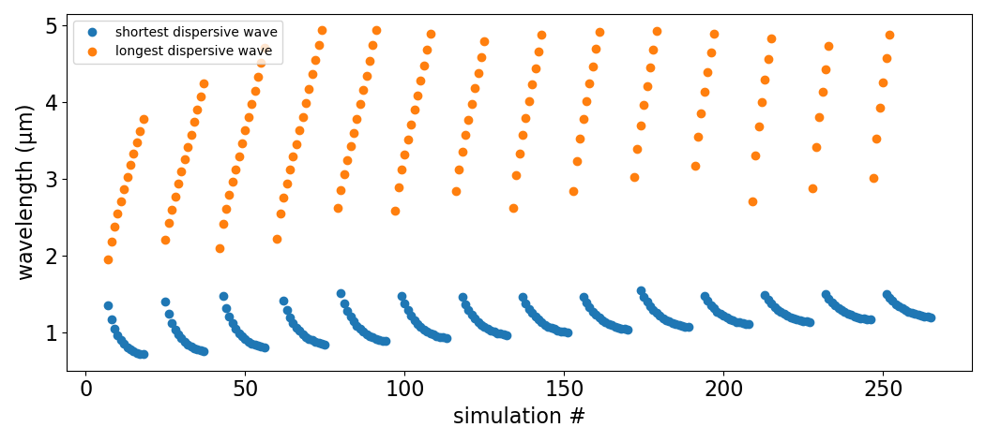
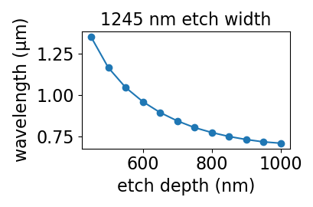
SPM: dispersive wave generation
etch width
MIR
visible
The etch depth is swept at fixed etch width for each “set”
Notes:
I noted that the location of the dispersive wave in the simulation occurs about exactly where it’s predicted to occur by the phase mismatch calculation, which is a good sanity check. In these simulations I accidentally used 1560 nm as the pump rather than 1550 nm, but I don’t think that is a big deal.
The PyNLO simulations can be used to predict, however, what the conversion efficiency is for that dispersive wave. For example, the ones that occur close to 5 um have pretty large mode area.

Slide 20
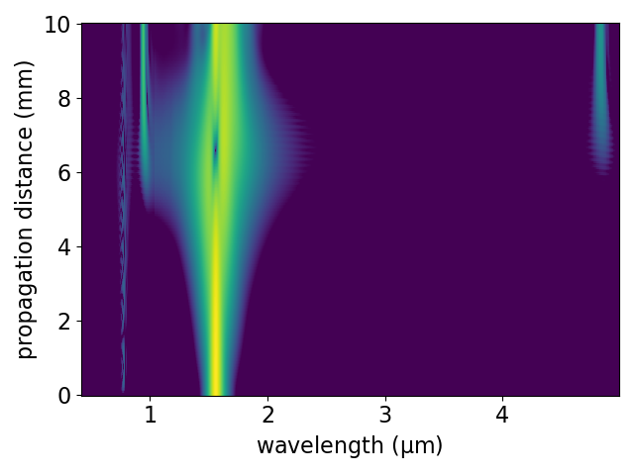
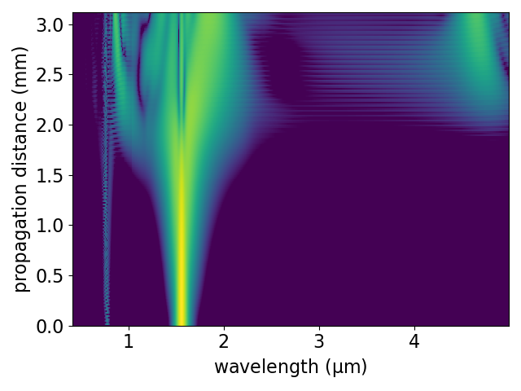
Pulse energy comparison for longer wavelengths
100 pJ
300 pJ
The location of the dispersive wave is more or less determined entirely by the dispersion
The conversion efficiency can be very dependent on pulse energy. Higher pulse energies are needed to push out to longer wavelengths

Slide 21
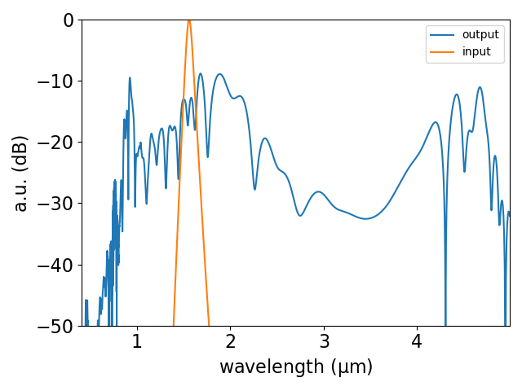
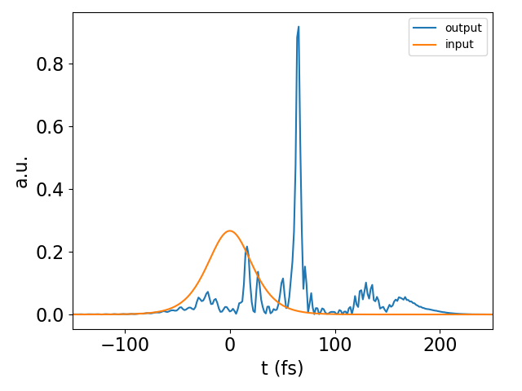
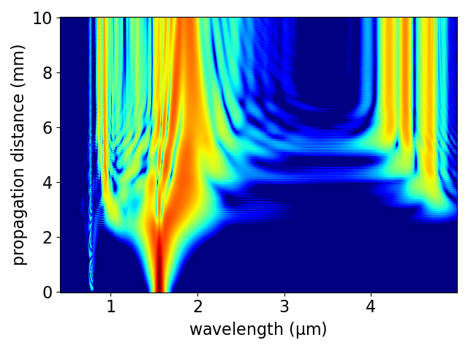
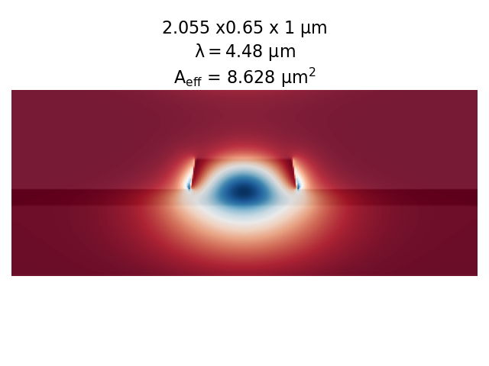
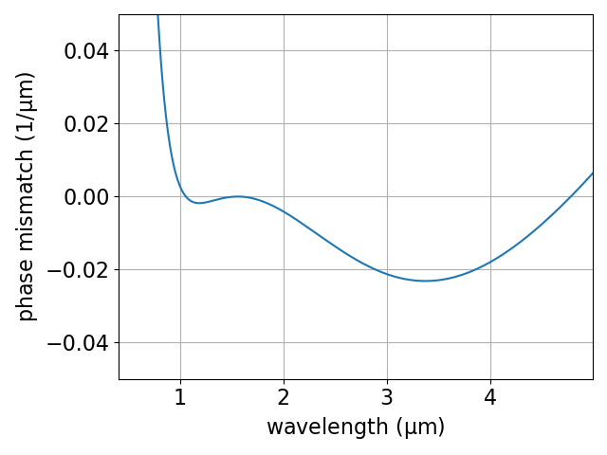
A particular example: 300 pJ

Slide 22
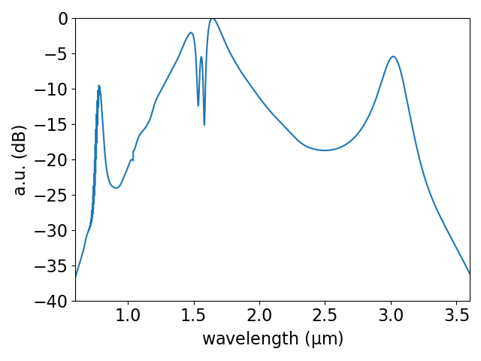
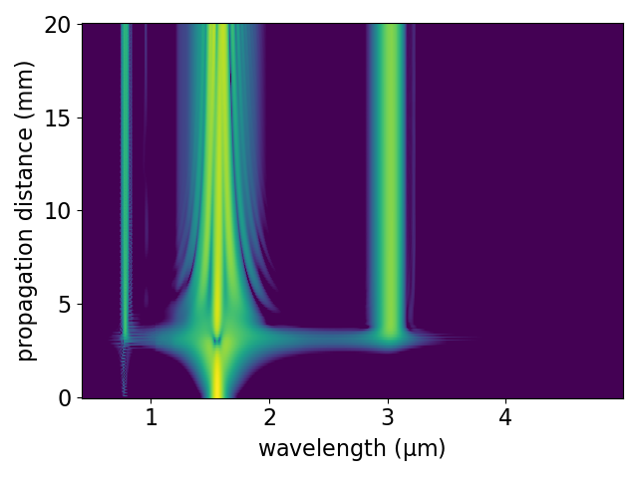
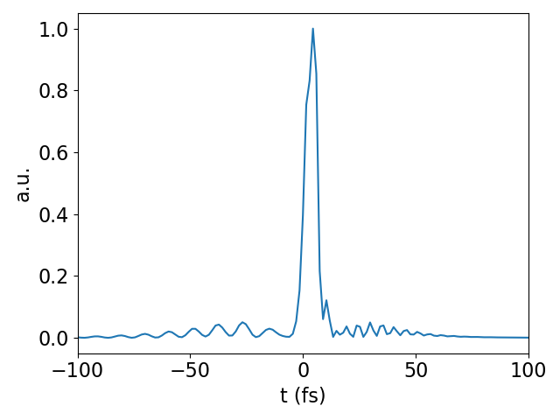
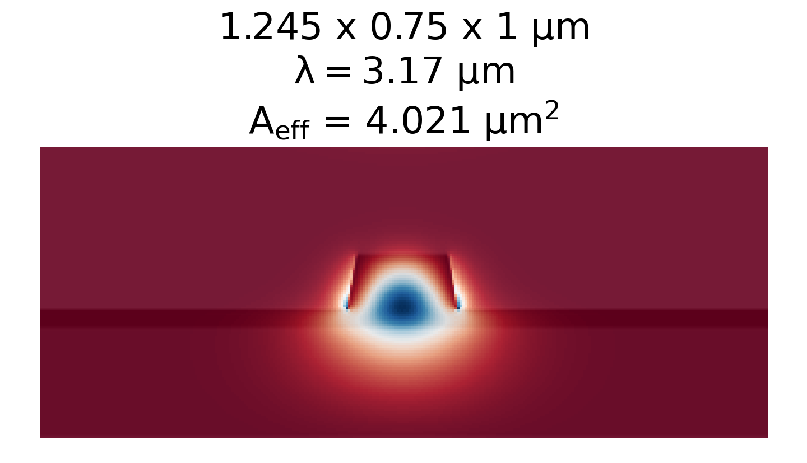
A particular example: 100 pJ

Slide 23
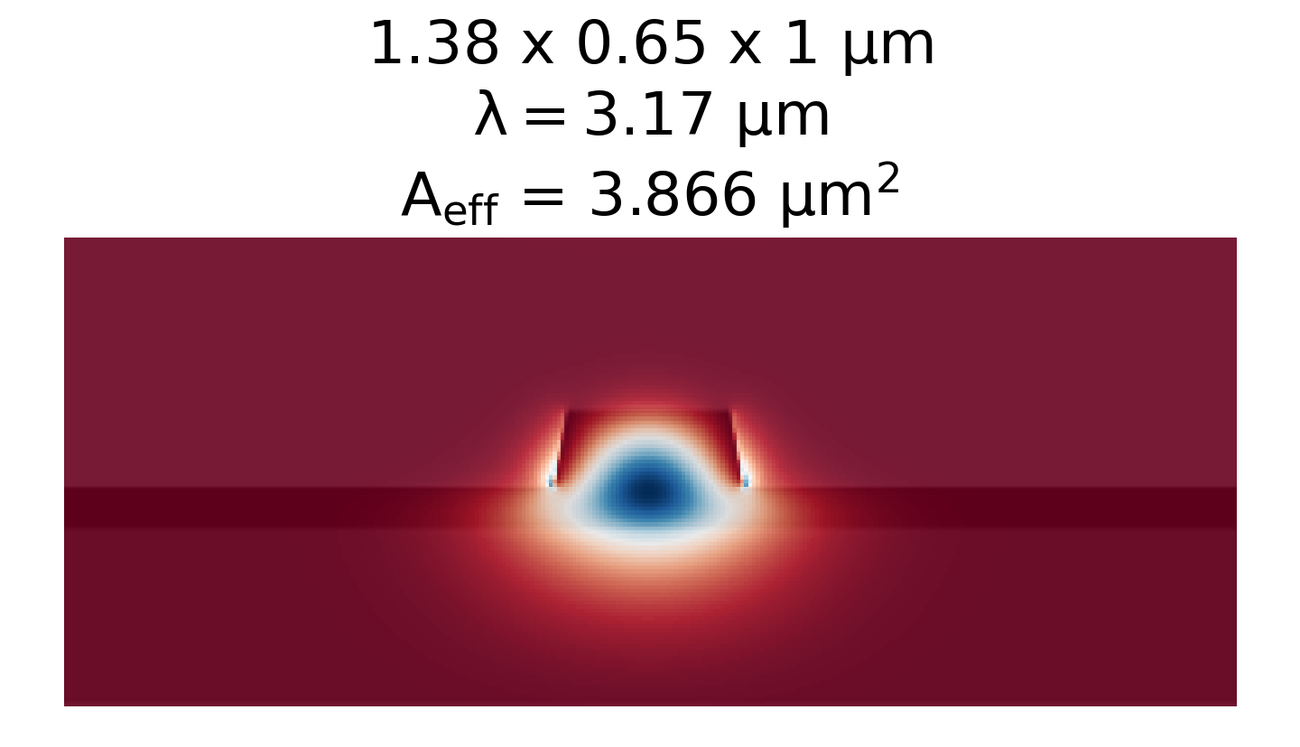
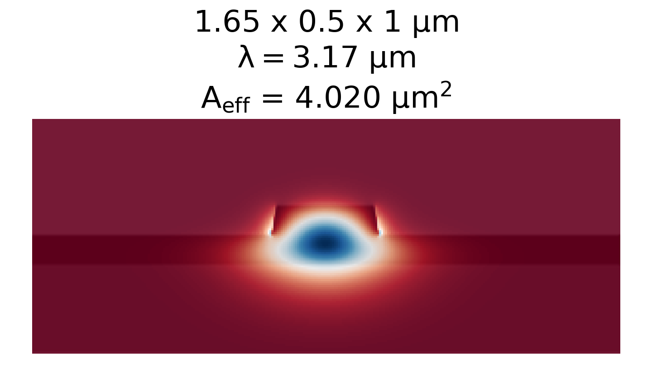
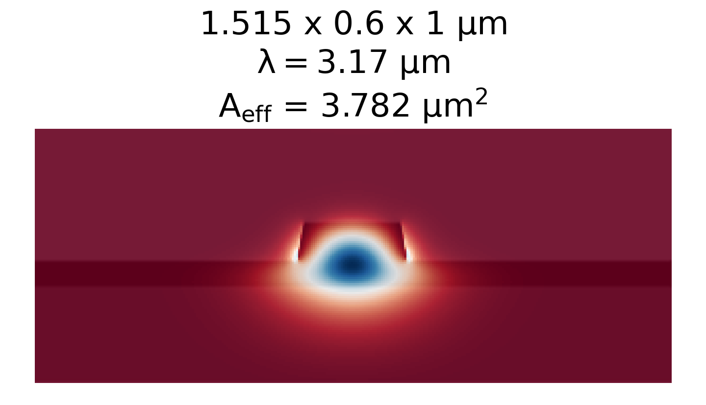





100 pJ, 50 fs pulse

